Slide 1
Excercise 3 Increasing Well-Being with Data Analytics
Summer Term 2021
Notes:
Lassen Sie uns starten. Ich darf Sie recht herzlich begrüßen zur Veranstaltung IbG, eine Veranstaltung, die in den Themenbereich Entrepreneurship fällt.

Slide 2
Agenda
Data Analytics and Regression Analysis
Ordinary Least Squares (OLS)
Hypothesis Testing: The t-test
Notes:
Heute findet also der Kick-off zur Veranstaltung statt.
Ich werde Ihnen also einen Überblick über die Inhalte und Veranstaltungsteile geben.
Warum fokussieren wir gerade Internet-basierte Geschäftsmodelle?
Wie können Sie das, was Sie hier lernen, auch in der Praxis konkret anwenden?
Wie sieht die Struktur der Veranstaltung aus?
Welche Teilleistungen müssen Sie erbringen?

Slide 3
What is Data Analytics?
“a careful and complete analysis of data using a model, usually performed by a computer; information resulting from this analysis”.¹
Within data analytics (inferential) statistics are utilized to draw conclusions from a population sample in order to identify potential causal relationship between the independent and the dependent variables.²
Data Science and Data Analytics can be considered an applied branch of statistics.³
1 Oxford Dictionary
Judd, Charles and, McCleland, Gary (1989). Data Analysis. Harcourt Brace Jovanovich. ISBN 0-15-516765-0.
Donoho, D. (2017). 50 years of data science. Journal of Computational and Graphical Statistics, 26(4), 745-766.

Slide 4
Regression Analysis
Comprehensive Methodology to analyze quantitative data (usually including at least one numerical variable):
“set of statistical processes for estimating the relationships between a dependent variable and one or more independent variables”
Most widely applied methodology to perform (inferential) statistical analyses
Typical data sources:
Survey, (Field) Experiment, Observational Data
Source: https://en.wikipedia.org/wiki/Regression_analysis

Slide 5
Agenda
Data Analytics and Regression Analysis
Ordinary Least Squares (OLS)
Hypothesis Testing: The t-test
Notes:
Heute findet also der Kick-off zur Veranstaltung statt.
Ich werde Ihnen also einen Überblick über die Inhalte und Veranstaltungsteile geben.
Warum fokussieren wir gerade Internet-basierte Geschäftsmodelle?
Wie können Sie das, was Sie hier lernen, auch in der Praxis konkret anwenden?
Wie sieht die Struktur der Veranstaltung aus?
Welche Teilleistungen müssen Sie erbringen?

Slide 6
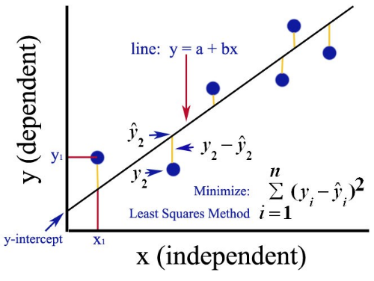
Fundamental Regression Model: ordinary least squares (OLS)
OLS: method for estimating the unknown parameters in a linear regression model
line: ŷ = Xβ
Sources:
https://medium.com/analytics-vidhya/ordinary-least-square-ols-method-for-linear-regression-ef8ca10aadfc; https://en.wikipedia.org/wiki/Ordinary_least_squares

Slide 7
Fundamental Regression Model: ordinary least squares (OLS)
OLS: method for estimating the unknown parameters in a linear regression model.
line: ŷ = Xβ
Sources:
https://medium.com/analytics-vidhya/ordinary-least-square-ols-method-for-linear-regression-ef8ca10aadfc; https://en.wikipedia.org/wiki/Ordinary_least_squares

Slide 8
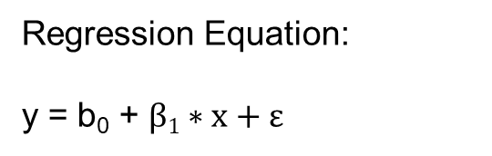
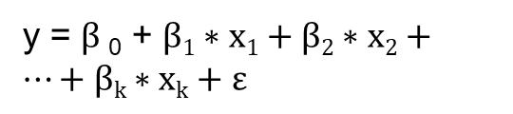
Fundamental Regression Model: ordinary least squares (OLS)
OLS: method for estimating the unknown parameters in a linear regression model.
Regression Equation:
y = b₀ + $β1∗x+ε$
line: ŷ = Xβ
y = $β$₀ + $β1∗x1+β2∗x2+…+βk∗xk+ε$
Sources:
https://medium.com/analytics-vidhya/ordinary-least-square-ols-method-for-linear-regression-ef8ca10aadfc; https://en.wikipedia.org/wiki/Ordinary_least_squares

Slide 9
Agenda
Data Analytics and Regression Analysis
Ordinary Least Squares (OLS)
Hypothesis Testing: The t-test
Notes:
Heute findet also der Kick-off zur Veranstaltung statt.
Ich werde Ihnen also einen Überblick über die Inhalte und Veranstaltungsteile geben.
Warum fokussieren wir gerade Internet-basierte Geschäftsmodelle?
Wie können Sie das, was Sie hier lernen, auch in der Praxis konkret anwenden?
Wie sieht die Struktur der Veranstaltung aus?
Welche Teilleistungen müssen Sie erbringen?

Slide 10
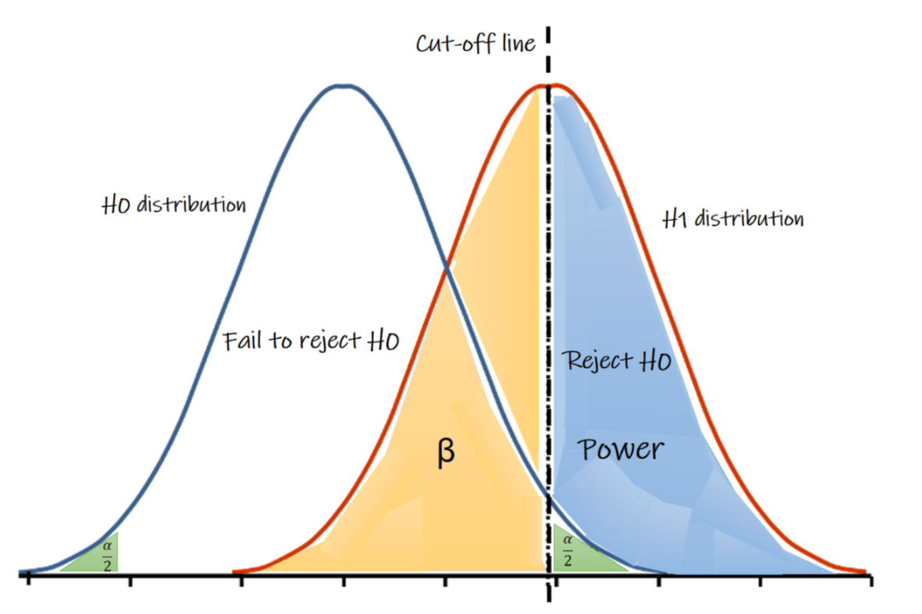
Hypothesis Testing: The t-test
To test if we have an significant independent variable we can use hypothesis testing such as an t-test
To understand hypothesis testing we have to think of two variables:
H0: Null hypothesis — the default no-difference hypothesis we are trying to reject.
H1: Alternative hypothesis — the difference hypothesis.
α (type 1 error)
Source: https://medium.com/evidentebm/the-value-of-the-p-value-9460797a92d6

Slide 11
Hypothesis Testing: The t-test
The β estimators are derived from random distributed data, therefore, parameter values of OLS regressions can be tested.
To test if an independent variable of an regression has we set our hypothesis as followed:
H0: Null hypothesis β = 0 | H1: Alternative hypothesis β ≠ 0
α (type 1 error)
Source: https://medium.com/evidentebm/the-value-of-the-p-value-9460797a92d6

Slide 12
Regression: P-Value
As result and reference of the t-test on β, we receive an p-value.
The p-value is in combination of an self defined cut-off of α (usually 0.05) the indicator if the value of β is statistical significant.
If p-value<α (eg; p-value=0.02), we reject the null hypothesis and say there is a statistically relevant difference, but if p-value≥α (eg; p-value=0.50) we cannot reject the null hypothesis and there is no statistically relevant difference.
The p-value indicates the probability of the result occurring by chance.
Source: https://medium.com/evidentebm/the-value-of-the-p-value-9460797a92d6

Slide 13
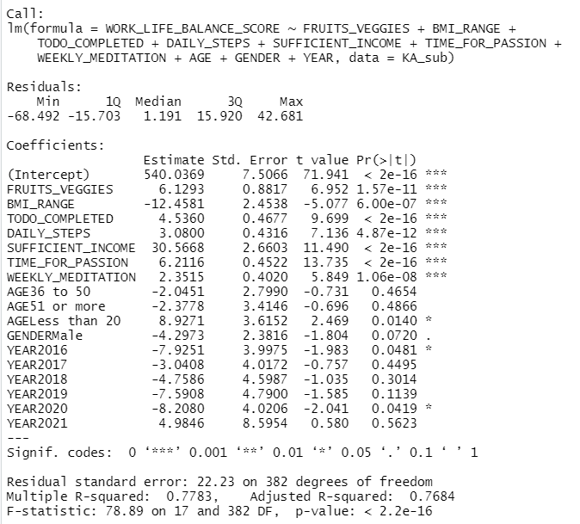
OLS-Regression output in R
regression model
parameter estimates
p-values

Slide 14

Thank You!

